Slide 1
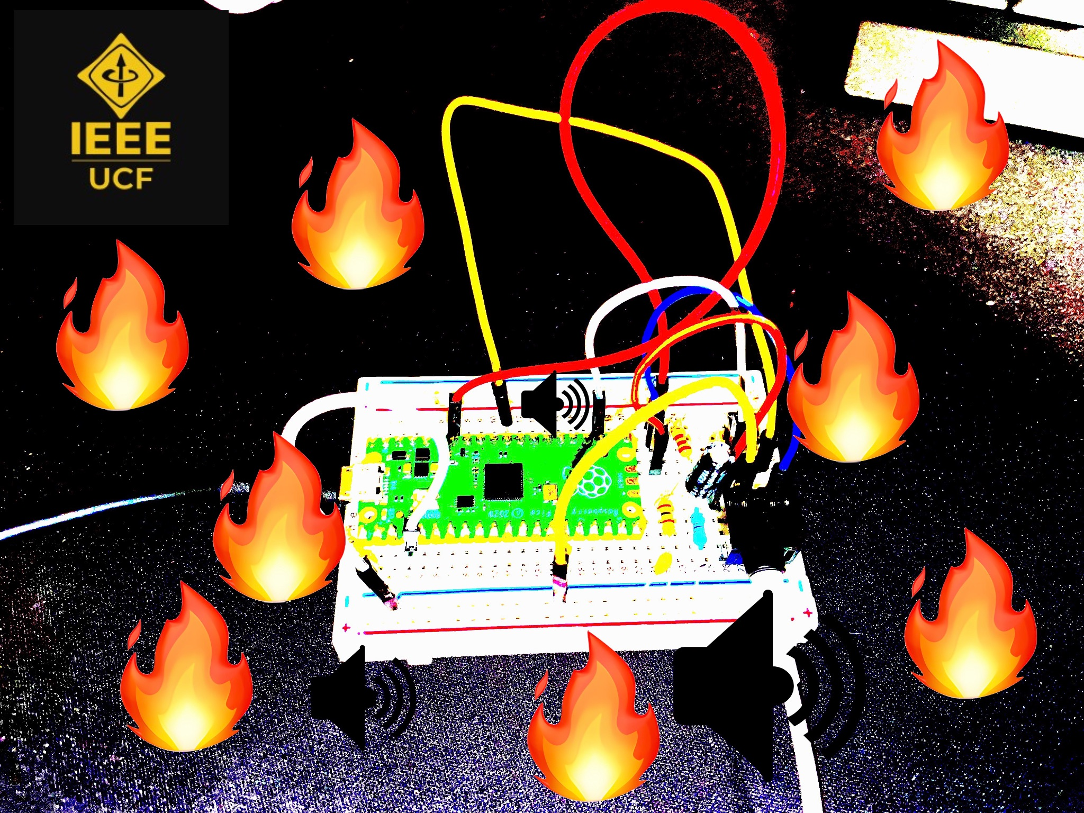
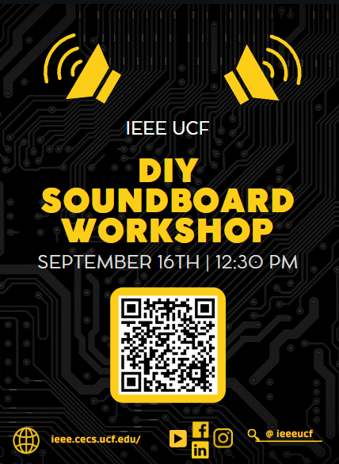

DIY Soundboard Workshop
Fall 2023

Slide 2
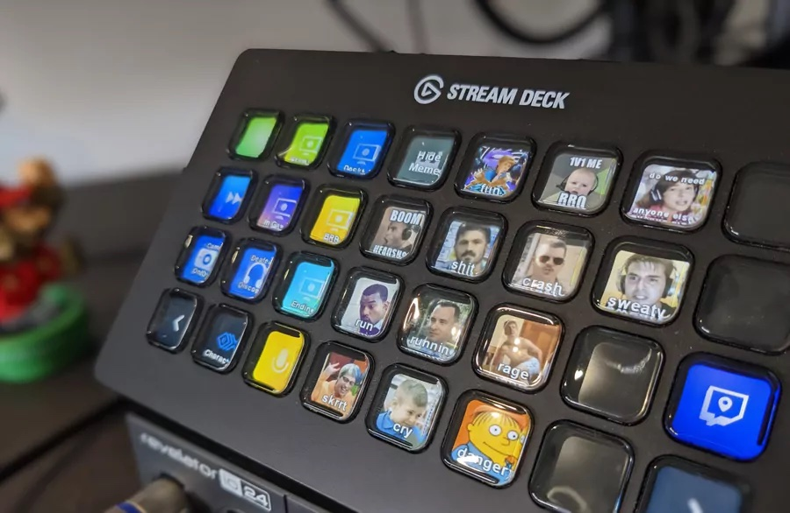
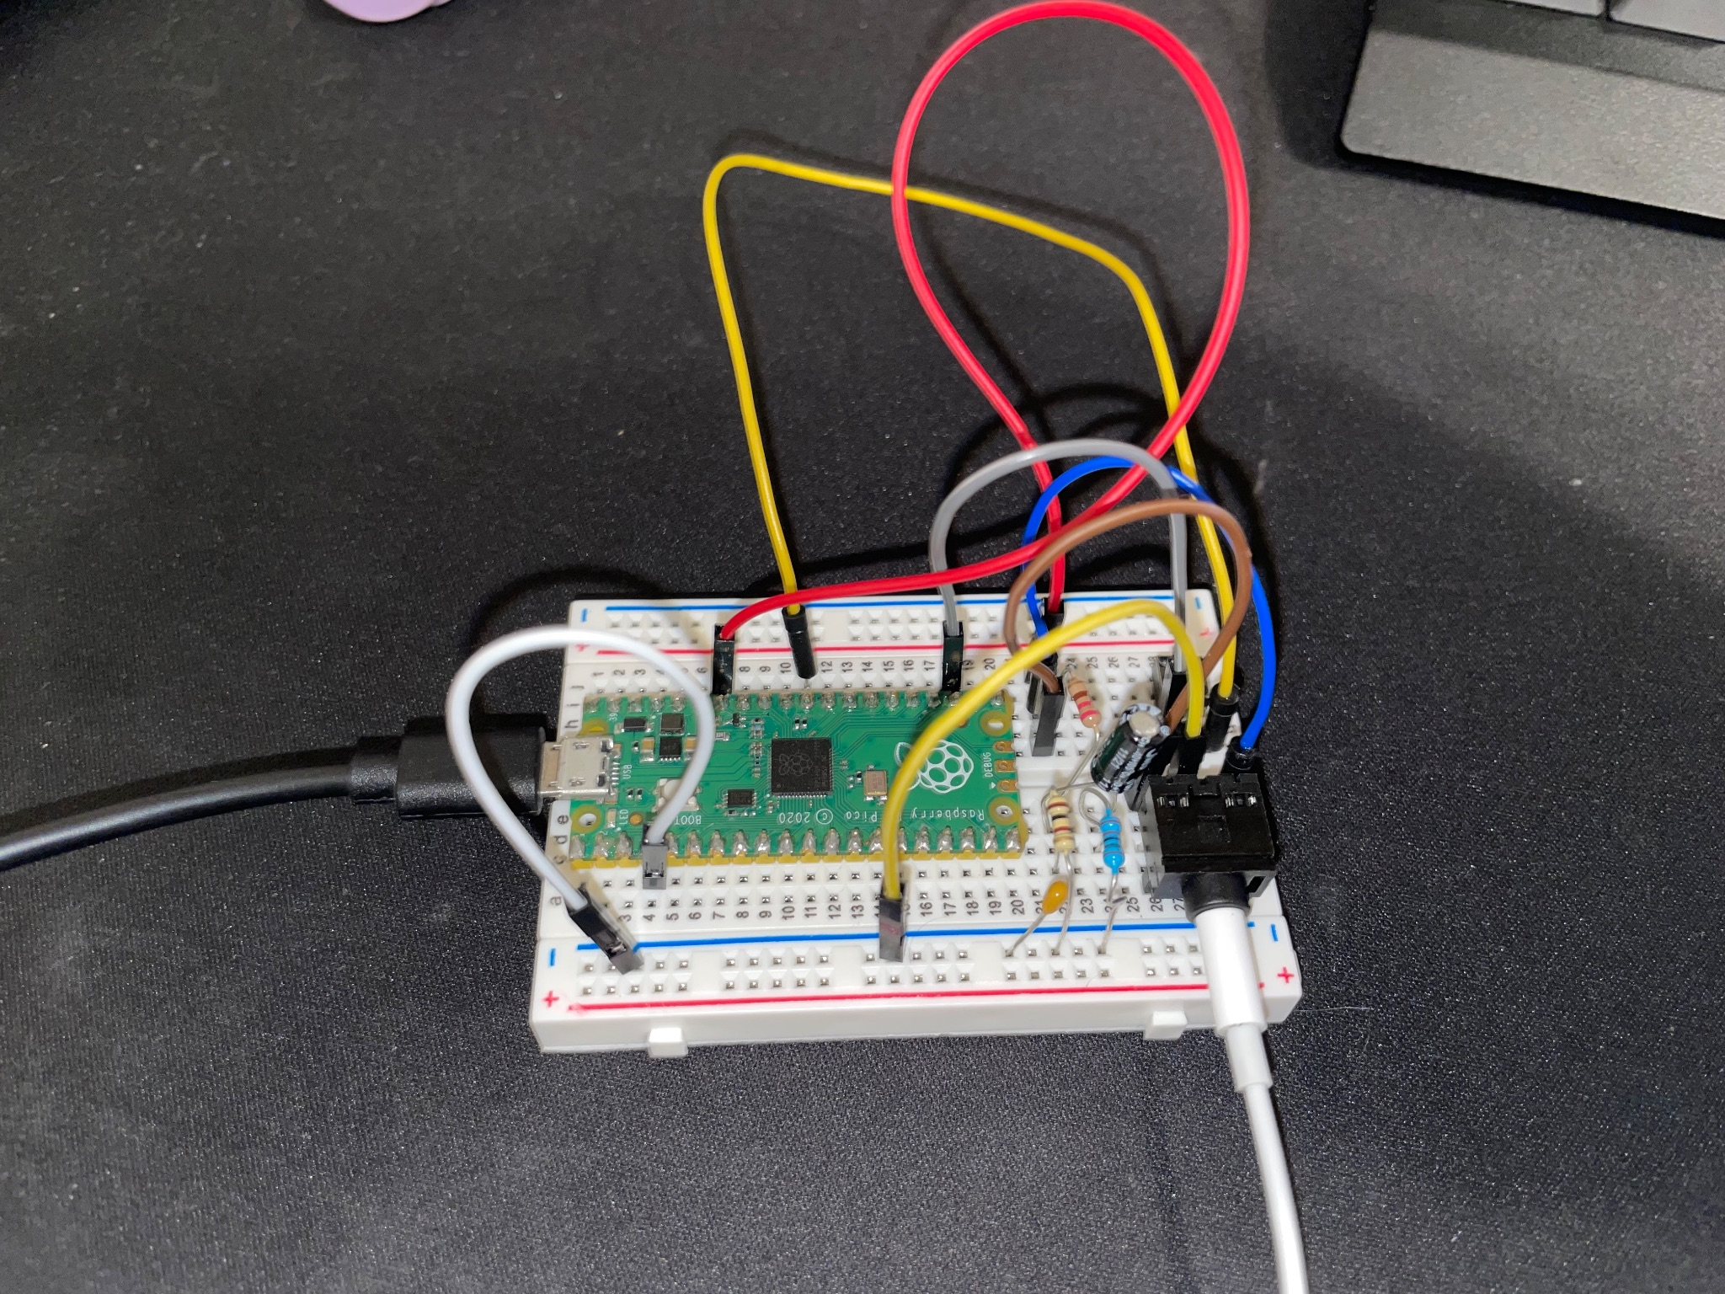
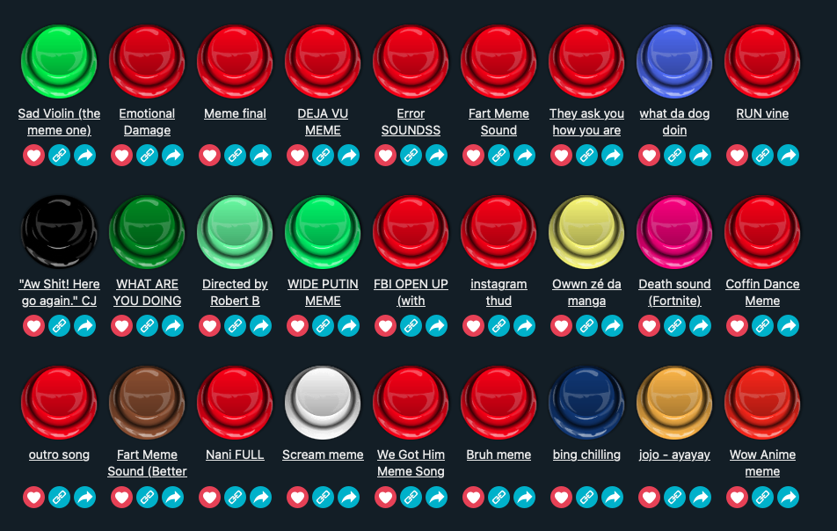
What is a soundboard?
Push button -> Play sound
Takes audio signal from Raspberry Pi Pico
Filters frequencies
Outputs to speaker

Slide 3
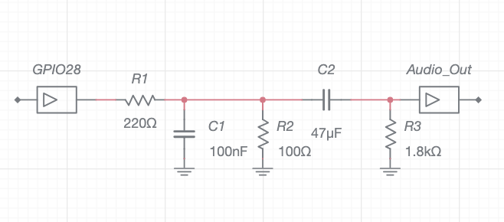

Circuit Design

Slide 4
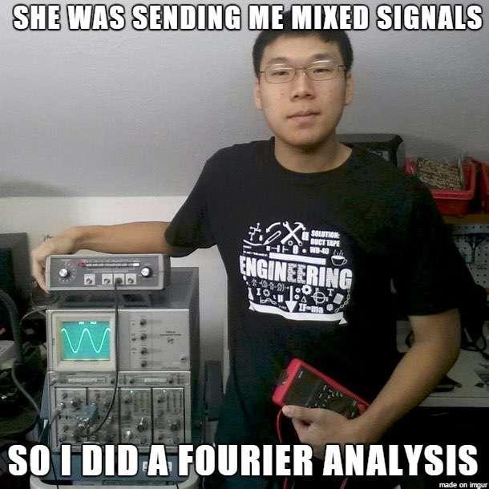

What you’ll learn about
Breadboarding
Arduino IDE
Microcontroller
Digital Audio

Slide 5

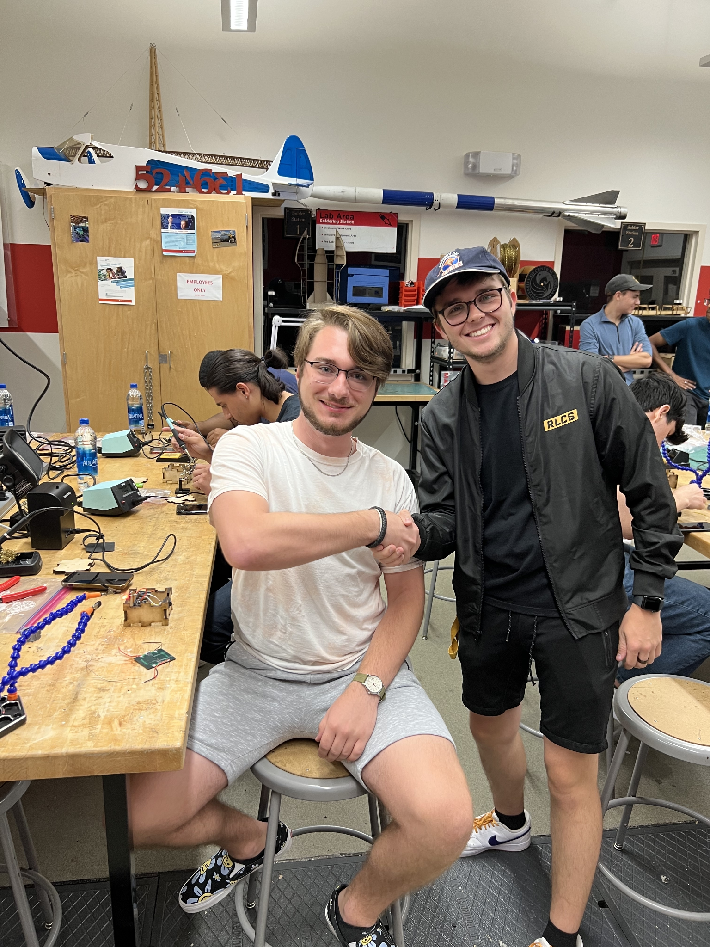
Interested in joining Workshop Committee?
Come talk to us !

